Slide 1


Slide 2
GROUP MEMBERS
Hajra Talat-027
Shumail ata mir-050
Iqra Bashir-024
Bisma Shahzadi-023

Slide 3
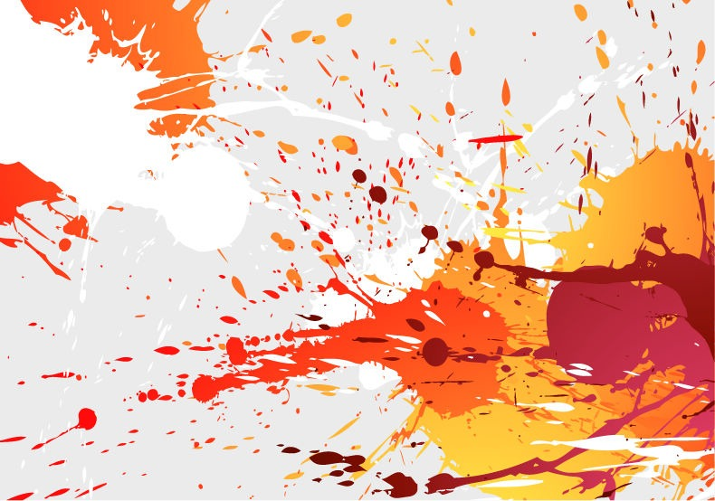
COLOURS & MOOD

Slide 4
What Is Color?
In 1666, English scientist Sir Isaac Newton discovered color and told that each color is made up of wave length which cannot be separated.
Different colors are combined to create different colors e.g red and yellow combines to make orange.

Slide 5

COLOUR PSYCHOLOGY

Slide 6
Colour Psychology
Color psychology is concerned with the effects of color on mood, emotion, behavior.
Certain colors can raise blood pressure, increase metabolism, or cause eyestrain.
research has shown that when our eyes connect with a color, our brains release different chemicals that impact us on a physical and emotional level.

Slide 7
Color therapy has been practiced in traditional healing professions for many years, but marketers and businesses more recently have also used color to shift human moods.
Once we learn a bit about the attributes of each color, we can use that information to promote the atmosphere we want in the different rooms of our homes

Slide 8
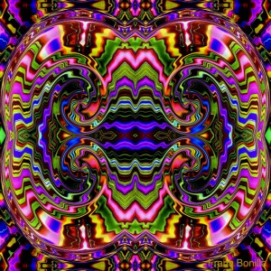
Psychological effects of colours

Slide 9
Psychological effects of colours
Colours have the ability to invoke in us a variety of moods. Although not everybody will have the same feelings seeing a certain colour (think about age and positive/negative memories related to a specific colour), the psychological effects are shared by the majority.
While perceptions of color are somewhat subjective, there are some color effects that have universal meaning

Slide 10
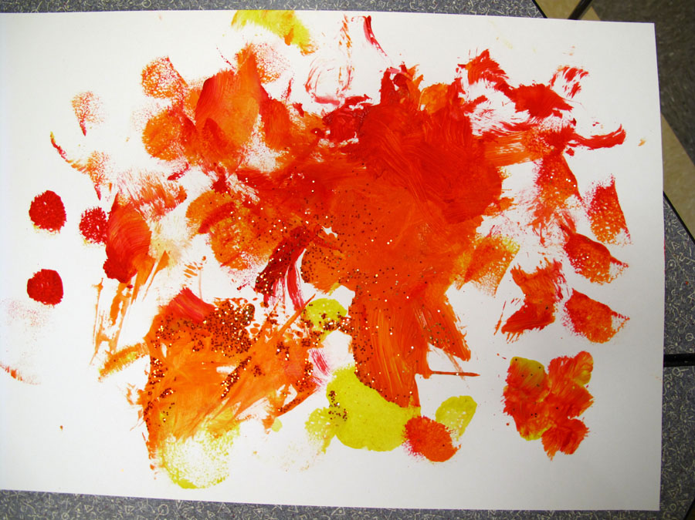
Psychological Effects of Warm Colors

Slide 11
Psychological Effects of Warm Colors:
Colors in the red area of the color spectrum are known as warm colors and include red, orange and yellow. These warm colors evoke emotions ranging from feelings of warmth and comfort to feelings of anger and hostility.

Slide 12
Continue.....
You do want to be careful about using bright colors like orange and especially yellow. They reflect more light and excessively stimulate a person’s eyes which can lead to irritation. You also probably don’t want to paint your dining room or kitchen these colors if you’re a calorie-counter.

Slide 13
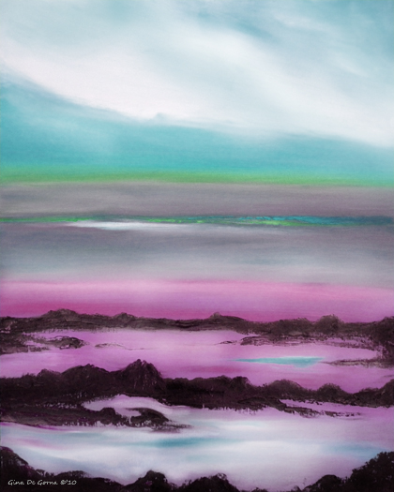
Psychological Effects of Cool Colors:

Slide 14
Psychological Effects of Cool Colors:
Colors on the blue side of the spectrum are known as cool colors and include blue, purple and green. These colors are often described as calm, but can also call to mind feelings of sadness or indifference.

Slide 15
Continue......
Are you looking for a peaceful and calming environment? You might consider using green and/or blue. These cool colors are typically considered restful. There is actually a bit of scientific logic applied to this – because the eye focuses the color green directly on the retina, it is said to be less strainful on your eye muscles.

Slide 16
Continue......
The color blue is suggested for high-traffic rooms or rooms that you or other people will spend significant amounts of time. Another cool color, blue is typically a calming and serene color, said to decrease respiration and lower blood pressure. The bedroom is a great place to use these colors as they should help you relax.

Slide 17
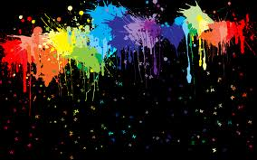
How different colours effect on mood ?

Slide 18
How different colours effect on mood:
color can influence our mood and our thoughts. Colors affect people in many ways, depending upon one’s age, gender, ethnic background or local climate. Certain colors or groups of colors tend to get a similar reaction from most people – the overall difference being in the shade or tones used. So it’s important to choose wisely.

Slide 19
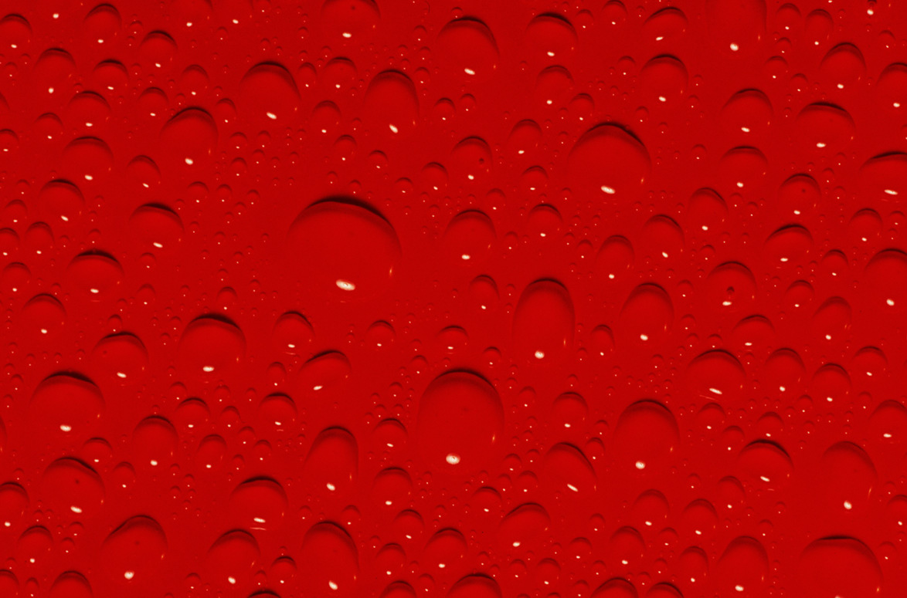
RED

Slide 20
associated with high energy and power.
signals courage, ambition and strength.
It promotes alertness and speed, and connects us to our physical self.
is too much red present, or if someone is sensitive to reds, they may experience feelings of irritation, anger or hostility.
Often, red is best suited as an accent color instead of the primary color in décor.

Slide 21

ORANGE

Slide 22
warm, inviting, and joyful color.
invokes feelings of sociability, enjoyable connection, and happiness.
promotes extroverted behavior - a fantastic color to use in gathering spaces to promote interaction and relationship.
Too much orange can create overwhelming, irritating or frustrating feelings.

Slide 23

YELLOW

Slide 24
colour ofoptimism, brightness, cheery attitude and mental clarity.
promotes creative, clear, upbeat thinking and decision making.
be helpful in easing depression and encouraging laughter.
over-exposure to yellow,can increase irritability, crying, hyperactivity, and can shorten tempers in babies and children (as well as adults).

Slide 25

GREEN

Slide 26
tremendously pleasing color.
has many positive qualities — invoking renewal, balance, refreshment and peace – which provides a calming influence and stress reducer.
An excellent way to bring green into your home spaces is with indoor houseplants or herb gardens.
to too much green can promote laziness and lack of initiative if overused.

Slide 27
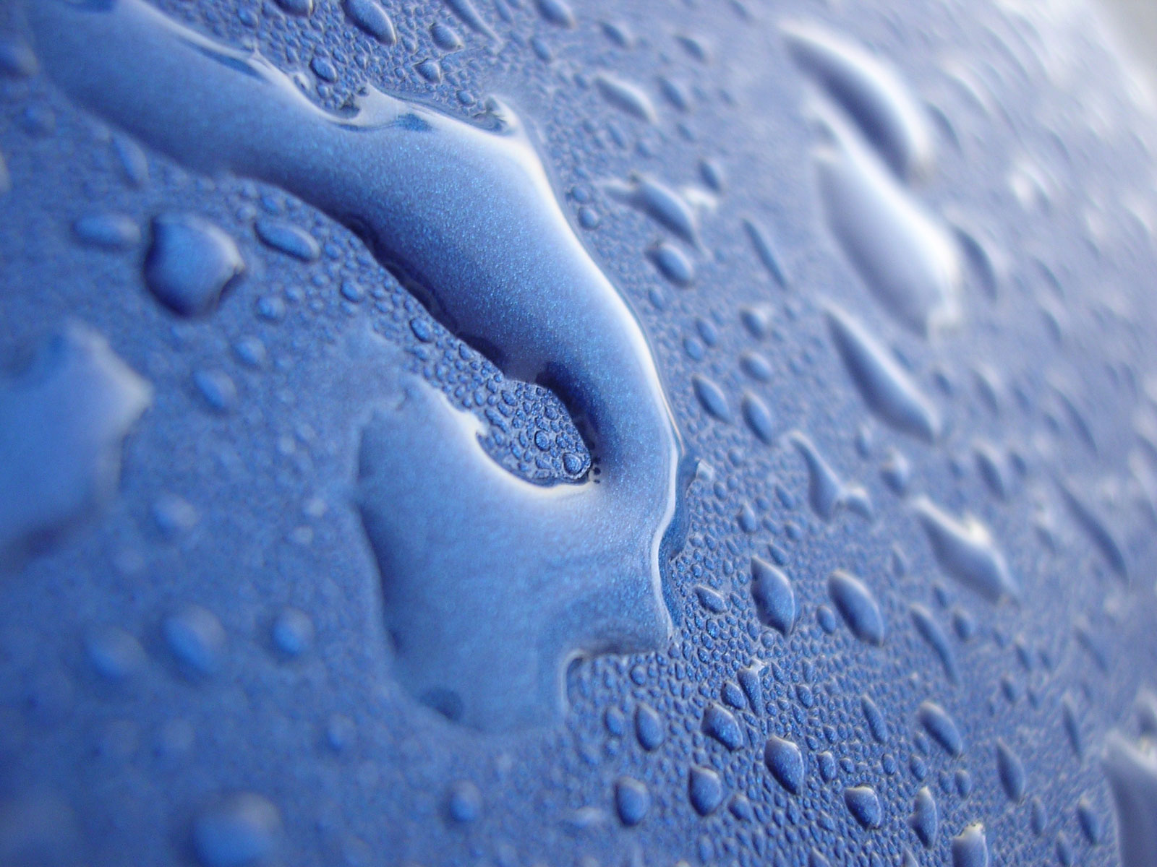
BLUE

Slide 28
promotes rest and calm.
effective to help ward off insomnia and promote a deep relaxing sleep.
help balance hyperactivity in children, and promotes imagination and intuitive thinking.
. Balancing blues with a warmer, more relational color is a great idea for gathering spaces in a home

Slide 29
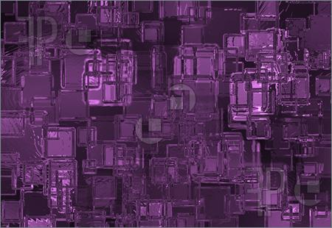
VIOLET

Slide 30
often the favorite color of adolescent girls.
stimulates the problem solving areas in our brain.
promotes creativity, intuition and artistic ability.
communicates richness and sophistication.
Overuse of violet may result in feelings of insecurity or suppression of emotions.

Slide 31
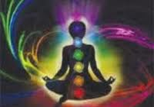
Colour Psychology as Therapy

Slide 32
Color Psychology as Therapy
Several ancient cultures, including the Egyptians and Chinese, practiced chromo therapy, or using colors to heal.
Chromo therapy is sometimes referred to as light therapy or colourology and is still used today as a holistic or alternative treatment.
In this treatment:
Red was used to stimulate the body and mind and to increase circulation.

Slide 33
Yellow was thought to stimulate the nerves and purify the body.
Orange was used to heal the lungs and to increase energy levels.
Blue was believed to soothe illnesses and treat pain.
Indigo shades were thought to alleviate skin problems.

Slide 34
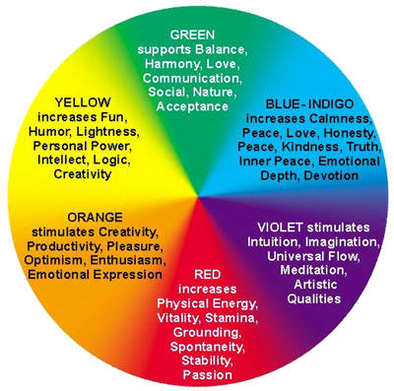

Slide 35
Most psychologists view color therapy with skepticism and point out that the supposed effects of color have been exaggerated. Colors also have different meanings in different cultures. Research has demonstrated in many cases that the mood-altering effects of color may only be temporary. A blue room may initially cause feelings of calm, but the effect dissipates after a short period of time.

Slide 36
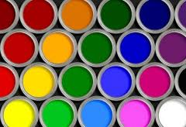
Common Colour Mood Chart

Slide 37
Common Color Mood Chart
Many scientists have written about the association between mood and color. For example blue is known to be a cold color and can put you in a depressed or sad mood. On the other end of the scale red is known as a hot fire color and is said to put humans in a state of rage or anger mood. Interior decorators use color mood charts when deciding on the color for a certain room.

Slide 38
Color Mood Chart
Black Color Mood Chart
TENSE
NERVOUS
HASSRASSED
OVER WORKED
White Color Mood Chart
FRUSTRATED
CONFUSSED
BORED

Slide 39
Common Colour Mood Chart
Grey Color Mood Chart
ANXIETIES
NERVOUS
STRAINED
Amber Color Mood Chart
NERVOUS
EMOTIONS
MIXED
UNSETTLED
COOL

Slide 40
Green Color Mood Chart
AVERAGE
READING
ACTIVE
NOT UNDER
GREAT STRESS
Purple Color Mood Chart
SENSUAL
CLARITY
PURPOSE

Slide 41
Bronze Color Mood Chart
JITTERS
ANTICIPATION
RESTLESS
THOUGHTS
Pink Color Mood Chart
FEAR
UNCERTAIN
UNANSWERED
QUESTIONS

Slide 42
